Slide 1

HotelHub
A collaborative effort by: Shiva Raman, raju choudhary

Slide 2
ABOUT PROJECT
HotelHub a system that provides us to reserving rooms, checking whether the rooms are vacant are or not etc by using online browsing. This system is very useful to all especially for business people.
For Business people they don’t have sufficient time for these then they can use these type of online Hotel Management Systems. By this project we will reduce the faults in bills of their expenditure and decrease time of delay to give the bills to the customers. We can also save the bills of the customer. By this project we can also include all the taxes on the bills according to their expenditures. It has a scope to reduce the errors in making the bills. Computerized bill can be printed within fraction of seconds. Online ordering of Booking is possible by using this software.

Slide 3

Why HotelHub
The old manual system was suffering from a series of drawback. Since whole of the system was to be maintained with hands the process of keeping, maintaining and retrieving the information was very tedious and lengthy. The records were never used to be a systematic order there used to be lots of difficulties in associating any particular transaction with a particular context. If any information was to be found it was required to go through the different registers, documents there would never exit anything like report generation. There would always be unnecessary consumption of time while entering records and retrieving records. Once the records were entered it was very difficult to update these records.

Slide 4

Existing features
HotelHub" has been designed to computerize the following functions that are performed by the system :
Room Detail Functions
Opening a New Room
Modification to Room assigned
Check-in and check-out Functions
Sign-up of New customer
Room assigning related to customer's need Statement of customer Details
Room DetailsIndividual customer Report.

Slide 5

Software requirement
System development software
• Operating system: Windows 7 or above
Development platform: NetBeans
Language: Java Swing, Java AWT, MySql
User Requirement :
Operating System: windows 7,8,10

Slide 6
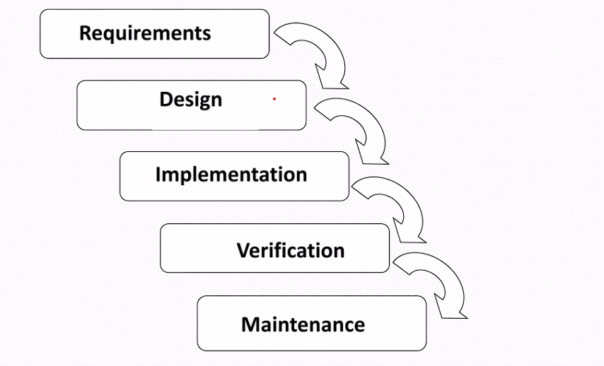
Using software process Model(waterfall model)

Slide 7
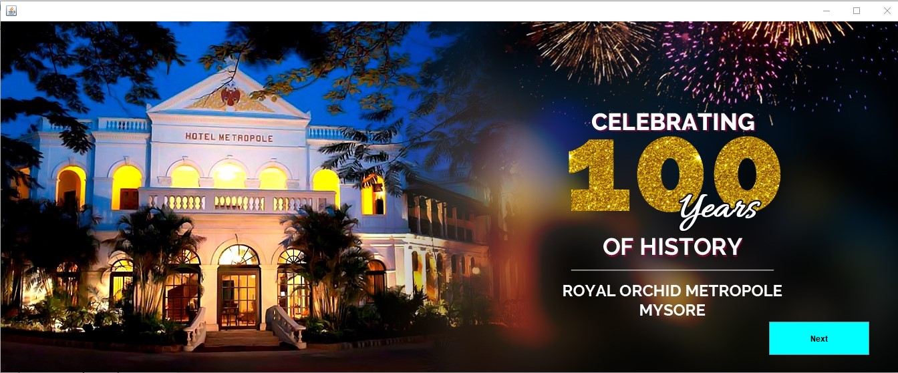
Output screenshots

Slide 8
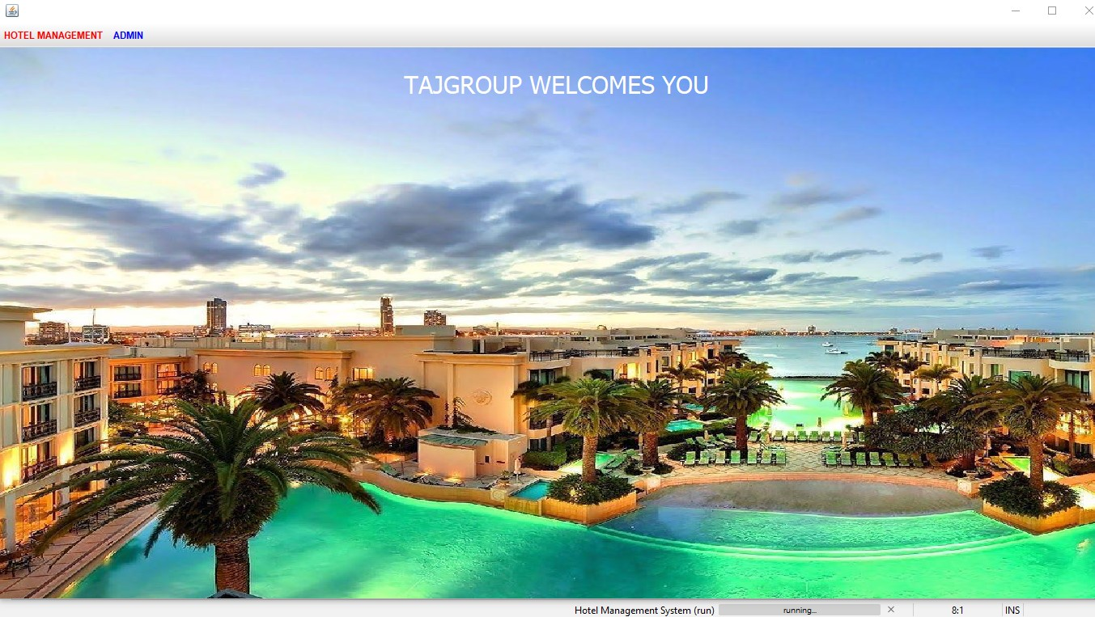
dashboard

Slide 9
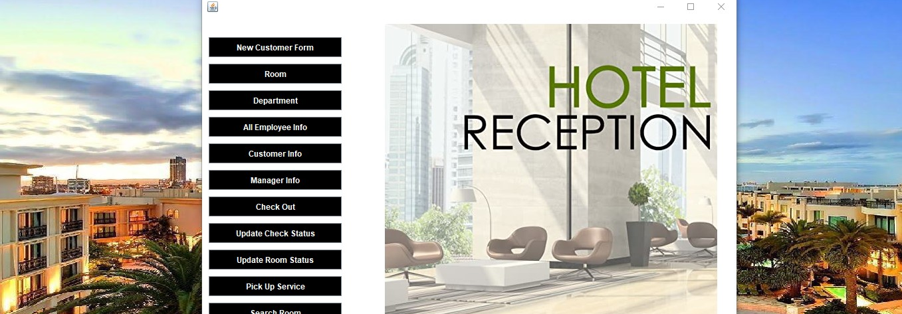
Reception module

Slide 10
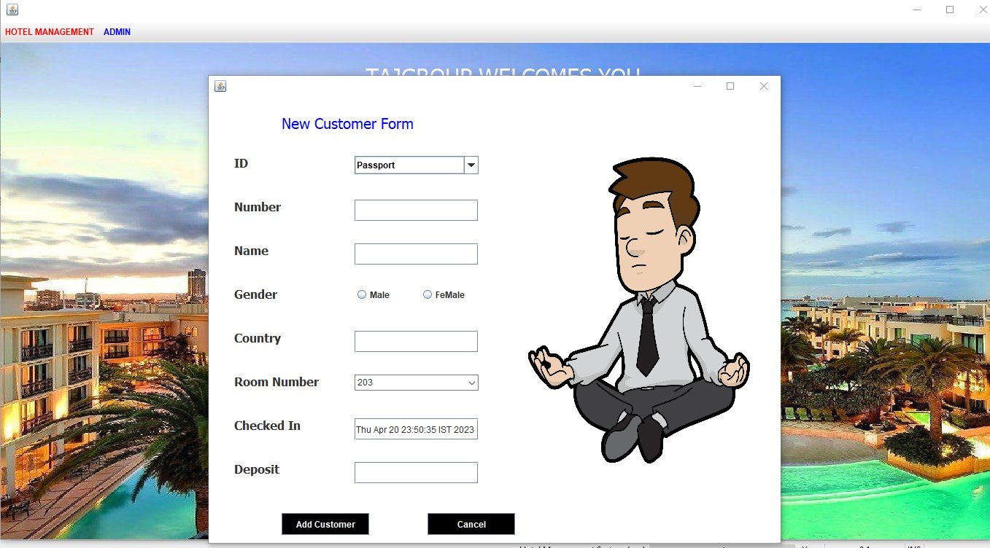
Customer form

Slide 11
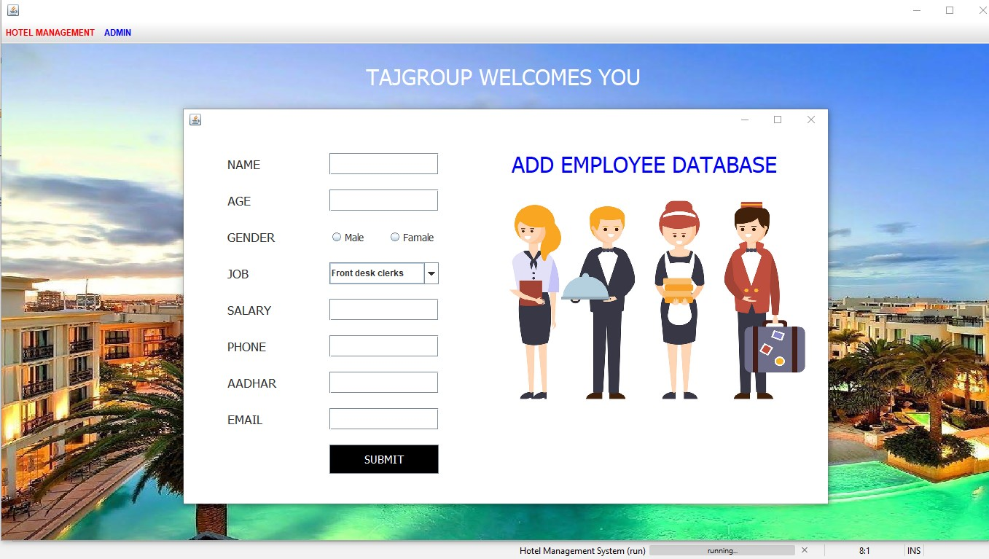
Management department

Slide 12
Project features
Reservation Management: This feature allows hotel staff to manage reservations made by guests, including creating new reservations, modifying existing reservations, and canceling reservations.
Front Desk Management: The front desk management feature includes check-in and check-out procedures, managing room assignments, managing room keys, and managing guest requests.
Room Inventory Management: This feature allows hotels to manage room inventory, including room availability, occupancy status, and room rates.
Housekeeping Management: This feature helps manage the housekeeping staff and their schedules, room cleaning status, and maintenance requests.
Point of Sale: This feature manages sales of goods and services in the hotel, such as food and beverages, room service, and spa services.

Slide 13

Thank you

